Slide 1

ETCAL
Award in Securing Progression
Unit A: Identify Suitable Opportunities.
mohaan.biswas@gateshead.ac.uk

Slide 2
Learning Outcomes
Understand requirements and strengths
Learn how to make informed choices
Develop an understanding of how to identify the right role

Slide 3
Introduction - Unit Aim
This unit introduces learners to identifying and understanding their requirements and strengths, along with the contribution they can make towards a positive working environment and the organisations that provide this. It encourages learners to make informed choices about the right type of organisation for them, their own requirements and how they influence their potential career opportunities.
This unit will help learners to develop an understanding of how to identify the right role and organisation for them and how that will contribute to their longer term career progression.

Slide 4
Strengths and weaknesses
Strength something you are good at – being on time.
Weakness - something you are not good at yet – spelling.
Notes:
Q1) List both your strengths and weaknesses

Slide 5
Identify Suitable Job Opportunities
Strengths…
Passionate, Enterprising, Reliable, Creative, Consistency, Patience, Versatile, Ambitious, Determines, Self-starter, Calm, Composed, Charisma, Competitive, Rational, Efficiency, Curiosity, Courteous, Perfectionist, Good Listener, Organised, Critical, Problem Solver, Collaborative, Empathy…
Weaknesses…
Competitive, Stubborn, Impulsive, Critical, Indecisive, Chaotic, Lateness, Perfectionist, Distracted, Introverted, Impatient, Passive, Sensitive, Conventional, Undisciplined, Anxious, Overbearing, Selfish, Procrastinator, Control Freak, Slow, Indifferent, Intolerant, Immature…

Slide 6
Discussion…
How can you improve upon your weaknesses?
What activities can you do to develop yourself?
Consider:
Building relationships
Planning, organising and prioritising
Improving communication skills
Focusing on the main issues
Finish what you start
Understanding limitations and identifying development opportunities.

Slide 7
How to improve on areas of weakness to increase suitable job opportunities
In an interview you will often be asked to name one of your weaknesses. This is an opportunity to show your willingness to develop your skills.
Identify something you are not current strong at
Explain what you can do to achieve your goal
List the personal qualities you have to achieve your goal
Outline your plan and how you overcome any hurdles
Notes:
Q2) Explain how to improve on areas of weakness to increase the suitable job opportunities
https://trainingmag.com/how-to-conduct-a-personal-s-w-o-t-analysis/

Slide 8
How to improve on areas of weakness to increase the suitable job opportunities
Identify something you are not current strong at:
I currently cannot write JavaScript.
Explain what you can do to achieve your goal:
However I have signed up to a three week course to learn how to write JavaScript.
List the personal qualities you have to achieve your goal:
I am really hard working and have already learn HTML in my own time so I feel confident I can achieve this.
Outline your plan and how you overcome any hurdles:
To achieve this goal I will set one hour every day aside to practice my skills. If there is anything I do not understand I will use W3Schools to support my
learning.
Notes:
Q2) Explain how to improve on areas of weakness to increase the suitable job opportunities
https://trainingmag.com/how-to-conduct-a-personal-s-w-o-t-analysis/

Slide 9
Skills and Qualities.
Which is a skill and which is a quality?
Skill
Quality
A. I enjoy helping others.
B. I can touch type.
A skill is something you can do, a quality is who you are as a person.
Notes:
Q3) Using your notes list both your Skills and Qualities below.

Slide 10
Skills and Qualities.
A skill is something you can do, a quality is who you are as a person.
Skill - I can touch type.
Quality - I enjoy helping others.
Notes:
Q3) Using your notes list both your Skills and Qualities below.
Skills…
Problem solving, Analytical reasoning, Critical thinking, Leadership, Adaptability, Team worker, Communication, Writing, Listening, Creativity, Social skills, Facilitation, People management, Time management, Work quality, Decision making…
Qualities…
Integrity, Independence, Self-motivation, Initiative, Confidence, Persuasion, Humility, Dependable, Helpful, Efficient, Trustworthy, Reliable, Perceptive, Creative, Mature, Open-Minded, Thoughtful, Considerate, Courteous, Talented, Educated…

Slide 11
Identify Suitable Job Opportunities
Skills…
Problem solving
Analytical reasoning
Critical thinking
Leadership
Adaptability
Team worker
Communication
Writing
Listening
Creativity
Social skills
Facilitation
People management
Time management
Work quality
Decision making…
Qualities…
Integrity
Independence,
Self-motivation,
Initiative
Confidence
Persuasion
Humility
Dependable
Helpful
Efficient
Trustworthy
Reliable
Perceptive
Creative
Mature
Open-Minded
Thoughtful
Considerate
Courteous
Talented
Educated…

Slide 12
Using Skills in career and personal life…
How do your skills contribute to your career?
Consider the ways your skills will contribute towards the work you do, or want to do. How they will help you develop and advance in your chosen environment.
How do your skills contribute to your Personal life?
Consider how your skills help you within your personal life, away from a work setting. What do they help you achieve, what do they allow you to do?

Slide 13
Sources of Job Opportunities…
What possible sources of information are available that identify job opportunities?
Search with online job boards
Visit company websites
Look at recruiter websites
Ask friends and family
Social Media
University Careers Sites
Personal Contacts
National & Local Newspapers
Think of examples of ‘Sources of Information’ – which ones have you used before?

Slide 14
Own suitability and readiness…
Q5 -
Consider 2 different job roles and consider how you are a suitable candidate for them. Think about both positive and negative issues that would make you suitable (or not) for the role.
Positives…
Previous experience
Technical knowledge
Transferable skills
Understanding of the industry
Ability to adapt and develop quickly to meet the requirements.
Negatives…
No previous experience
No knowledge in the required field
No knowledge of the industry and its requirements
Unable to meet the demands of the role (physically)

Slide 15
Career objectives…
Short term Goals
A short-term goal is something you want to do in the near future. The near future can mean today, this week, this month, or even this year. A short-term goal is something you want to accomplish soon.
Medium term Goals
Medium-term goals are set to be achieved somewhere between a person's short-term goals and long-term goals. Since long-term goals can take a long time to achieve, medium-term goals help a person stay motivated while they are taking the day-to-day short-term steps necessary for steady progress.
Long term Goals
Long-term goals help you think about jobs you want in the future. Careers take time and planning. These plans will include your long-term goals.

Slide 16
Career Goals
Short term goals – learning, overcoming fears, getting feedback, building relationships that might help you in the future.
Long-term goals – what role would you like to have in the next few years?
Notes:
Q5) Identify a long-term goal and related short-term goals below for potential job opportunity
Overcome your fears. Fear can prevent you from growing and progressing. If you are afraid of public speaking, for instance, take a class or join a group that helps people become better public speakers.
Read. Reading can expand your knowledge and vocabulary and keep you informed. It can also stimulate your mind and can improve your critical thinking skills.
Learn something new. Learn a new skill or topic, whether you do it yourself or sign up for a class. You might, for instance, take courses to learn another language, a new software program or how to write creatively.
Ask for feedback. Approach a family member, friend, colleague or manager, and ask them to give you feedback on a recent project or accomplishment. Use their positive comments as well as their constructive criticism to find ways to improve.
Observe others. Watch and learn from the people who inspire you. This could be someone you know, such as a supervisor, family member or public figure. Identify the qualities you admire in them and try to replicate those in yourself.
Network. By interacting with many types of people, you can learn new ideas and understand how to communicate and work with different personality types. You can also meet people and develop relationships that might help you in the future.
Keep a journal. Writing in a journal every day or week can help you gain self-awareness and reflect on recent events, decisions and conversations
Meditate. Many people meditate to gain clarity and awareness and to reduce stress and anxiety. Meditation can help you focus on your self-development and goals in a healthy, positive and calm way.
Get a mentor. If you need help identifying ways to build your self-development skills, talk to a mentor. This individual could be a manager, professor, someone you admire or a professional personal growth mentor..

Slide 17
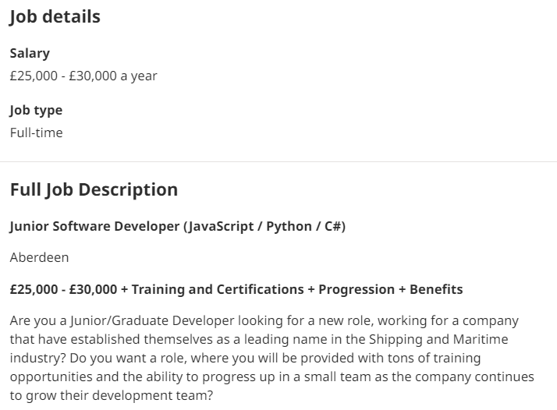
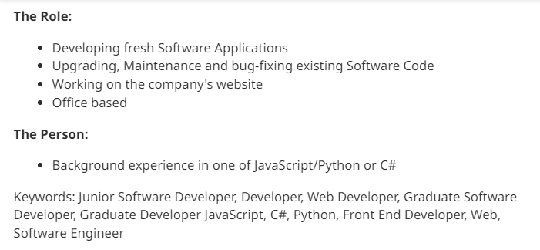
Job role positives and negatives
With any role there will be positives and negatives. For example a skill or experience you already have is a positive, something you do not have yet can be a negative.
a
a
a
a
x
Notes:
Q6) State your situation for the selection of two suitable job opportunities (This must include a positive and negative)

Slide 18
Identify suitable Job Opportunities
You can find out about job roles through word of mouth and on company websites.
A large number of roles can be found at job sites and though job agencies.
Notes:
Indeed, Monster, Glassdoor and LinkedIn, word of mouth, company website, agencies

Slide 19
Identify Suitable Job Opportunities…
For Q10 in the workbook, you are asked to provide three examples of job vacancies that interest you.
Please use the internet to look for/identify potential roles that you could apply for and document them in the workbook.
These should be genuine job vacancies and you should use the methods we discussed earlier to find them.

Slide 20
Support networks available…
What support networks are available for finding work?
Government website, Jobcentre Plus, LinkedIn, Find a Job Service, College & University internet sites, Industry specific support sites, Professional career coaching companies, Remploy, Job Help Campaign (Gov.uk), Citizen's advice…
How can you track an application for a job?
What methods could you use to keep track of your job applications? Consider what job it is, when you applied, when was the closing date and what was the outcome.

Slide 21
Activity
Now complete the Securing Employment Workbook…
Complete all questions within Unit A in the workbook.
Ensure all questions are fully answered and that correct English is used (grammar, spelling, etc.)
Answers should be suitable for the question – if it is asking for a description or explanation, then ensure you have given this and not just a bullet point list or single word answer.
Complete the Learner Feedback Page (see next slide…)

Slide 22
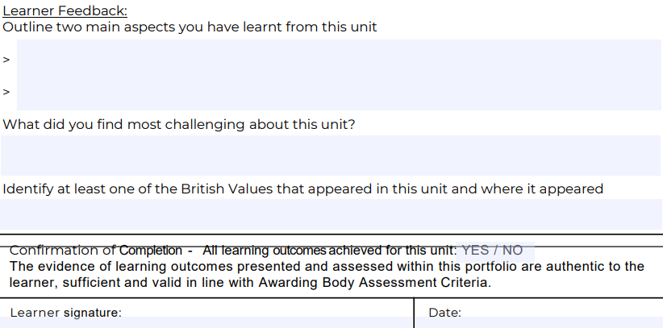
At the end of each unit…
Complete the ‘Learner Feedback’ section on the Assessment Feedback Sheet.
Sign the ‘Learner Signature’ box and add the date.

